Slide 1


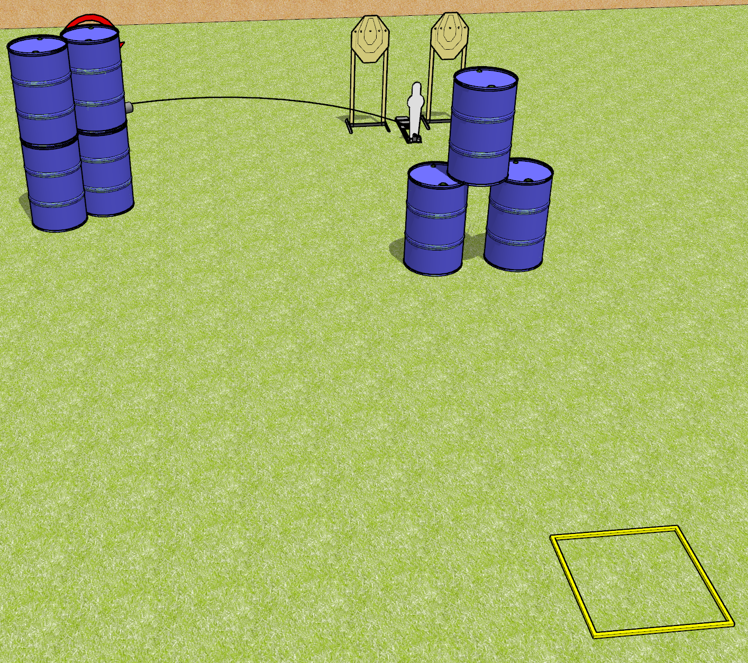
 | Dothan Gun Club – USPSA Match Down in Back Course Designer : Drew Coleman
Round Count 11 rounds 3 IPSC 1 Mini popper
Equipment List 1 swinger + activator

Slide 2
Down in Back
Written Stage Briefing
Down in Back is an 11 round, 55 point, Comstock speed shoot. There are 3 IPSC targets and 1 steel . The best 2 hits on the static paper will score, and best 6 hits on the swinger will score. Steel must fall to score.
The swinger is activated by the mini popper and is visible at rest. Please check the activator prior to walkthrough and set it the same way every time.
Handgun start position is in shooting box, wrists above shoulders. Handgun is loaded and holstered.
PCC start position is in shooting box, stock on belt. Loaded carbine is held with both hands, safety on.
The static paper and the mini popper are one array. The static paper require 2 hits each.
The swinger is another array, and requires 6 hits.
On start signal, engage 1 array, perform a mandatory reload, and engage the remaining array. You must perform a reload when changing between arrays.

Slide 3
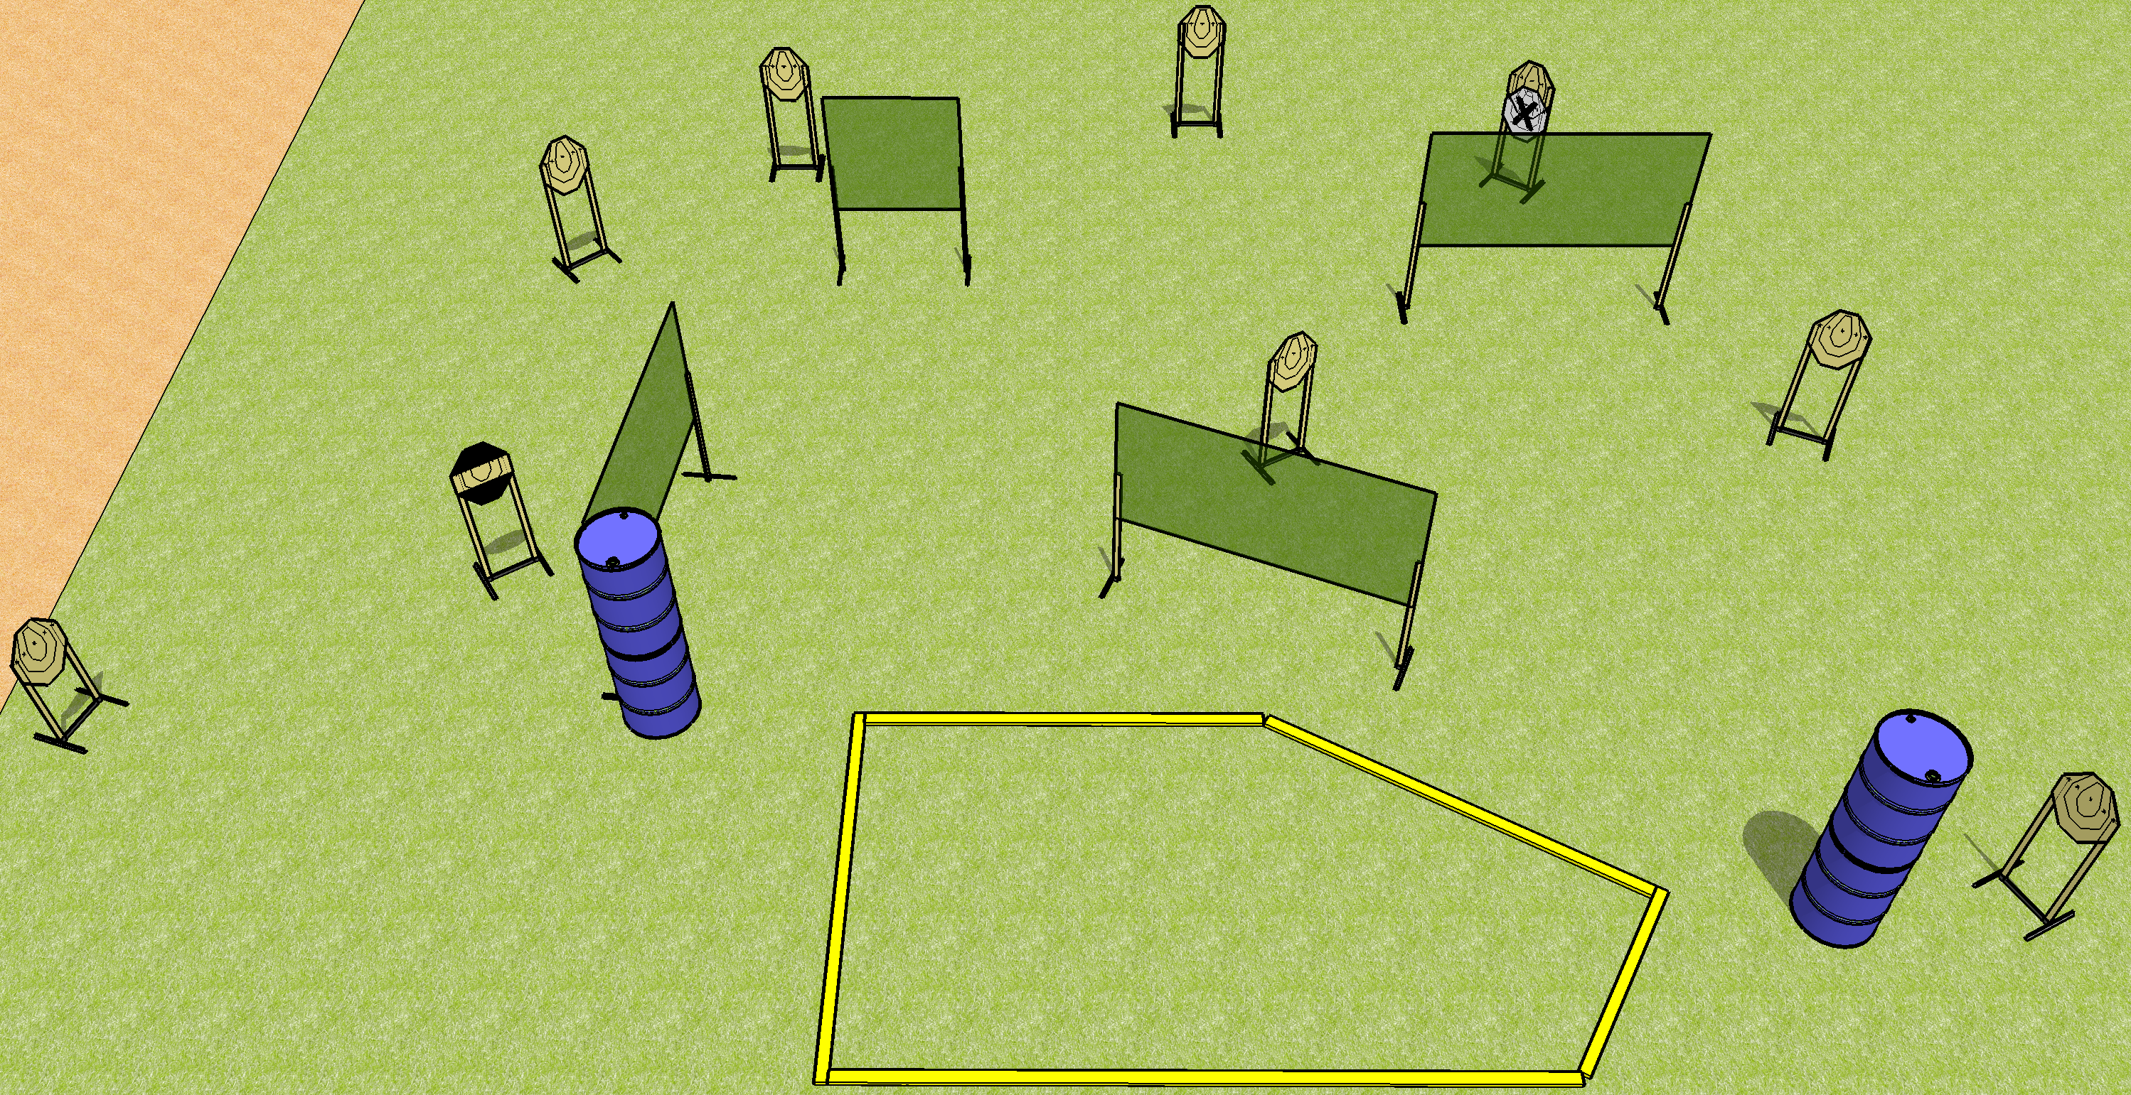
 | Dothan Gun Club – USPSA Match Off Like a Herd of Turtles Course Designer : Drew Coleman
Round Count 18 rounds 9 IPSC
Equipment List 8 wall feet 1 medium fault line 1 striped HC

Slide 4
Off Like a Herd of Turtles
Written Stage Briefing
Off Like a Herd of Turtles is an 18 round, 90 point, Comstock course of fire. There are 9 IPSC targets. The best 2 hits on paper will score. The start signal is audible.
Handgun start position is anywhere inside the shooting area, wrists below belt. Handgun is loaded and holstered.
PCC start position is anywhere inside the shooting area, stock on belt. Carbine is loaded, safety on.
On start signal, engage targets as they become available from within the shooting area.

Slide 5
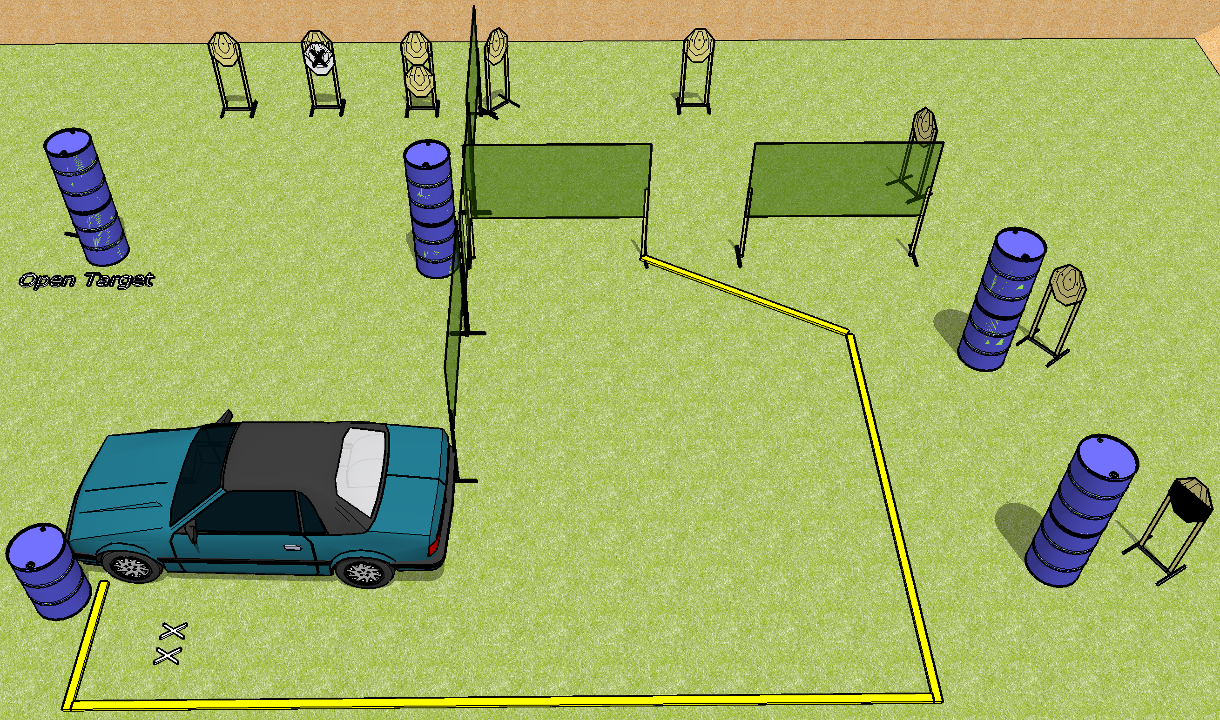
 | Dothan Gun Club – USPSA Match Oh Fu---- Course Designer : Drew Coleman
Round Count 20 rounds 10 IPSC
Equipment List Car 8 wall feet 1 half HC 1 medium fault line

Slide 6
Oh Fu----
Written Stage Briefing
Oh Fu---- is a 20 round, 100 point, Comstock course of fire. There are 10 IPSC targets. The best 2 hits on paper will score. The start signal is audible.
Handgun start position is both feet on X’s, holding hubcap in front of you. Handgun is loaded, placed on barrel.
PCC start position is both feet on X’s, holding hubcap in front of you. Carbine is loaded on barrel, safety on.
On start signal, engage targets as they become available from within the shooting area. The windows on the vehicle are ports, and must be used to engage the downrange targets.

Slide 7
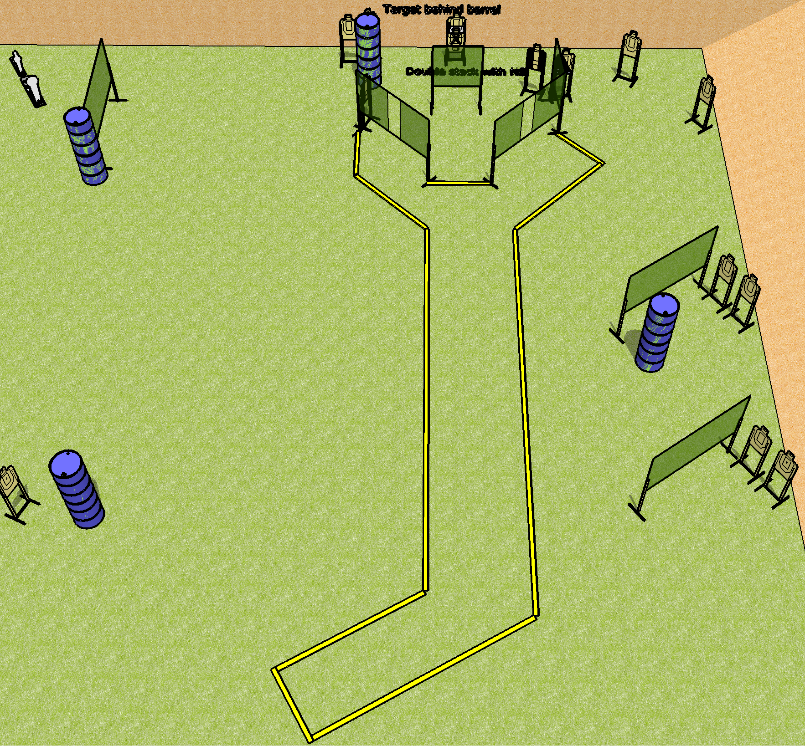
 | Dothan Gun Club – USPSA Match A Day at the Airport Course Designer : Drew Coleman
Round Count 30 rounds 14 USPSA 1 Colt popper, 1 mini popper
Equipment List 14 wall feet 2 tuxedos, 1 diagonal HC

Slide 8
A Day at the Airport
Written Stage Briefing
A Day at the Airport is a 30 round, 150 point, Comstock course of fire. There are 14 USPSA targets, 1 colt popper, and 1 mini popper. The best 2 hits on paper will score. The start signal is audible.
Handgun start position is anywhere inside shooting area, wrists below belt. Handgun is loaded and holstered.
PCC start position is anywhere inside shooting area, stock on belt. Carbine is loaded, safety on.
On start signal, shooter must retrieve the radio off the table next to the Glock 7, which costs more than you make in a month, and retain it during the course of fire. Any shots fired not retaining the radio will be a procedural per shot fired. The radio starts on the mark, on the table.

